Slide 1

第1章 正则语言与有限状态机
本章内容及要求：
简单的计算模型－有限状态模型
  确定型有限自动机 DFA
  非确定型有限自动机 NFA
有限状态模型识别的语言(能够解决的字符串判定问题)
  DFA=NFA(in terms of string decision power)
  正则语言RL，正则表达式RE
  RE = NFA = DFA (in terms of describing a language)
  非正则语言NRL (Pumping Lemma)

Slide 2
DFA – design a DFA
1. Building a DFA
Let ∑={0, 1}, Give DFA state diagrams for the following languages.
(a) L = {w | w contains the substring 001 }
(b) L = {a | the length of a is not divisible by 2 and not divisible by 3 }.

Slide 3
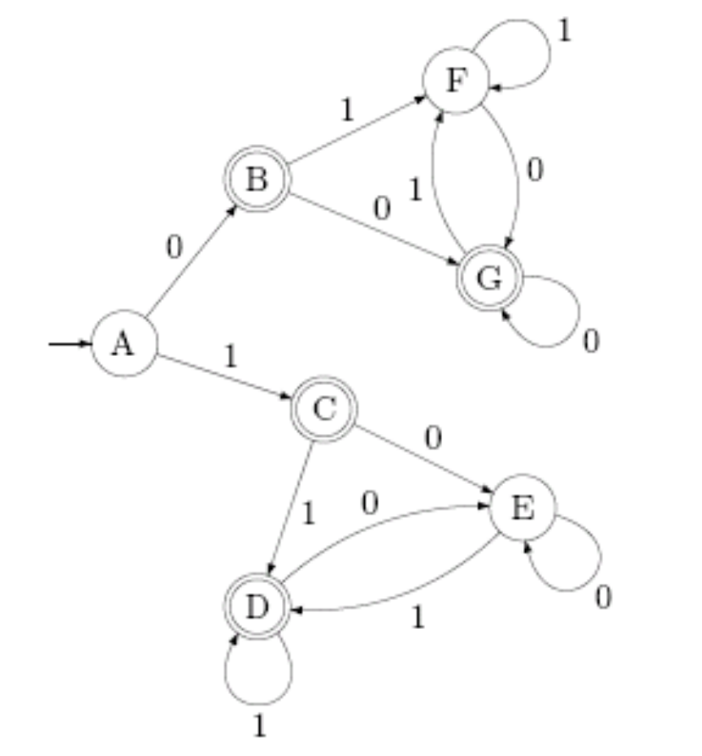
DFA – Interpret a DFA
2. What is the language of the following DFA? That is, explicitly specify all the strings that the following DFA accepts. Brief explain why your answer is correct.

Slide 4
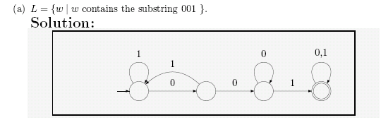
DFA – design a DFA
1. Building a DFA

Slide 5
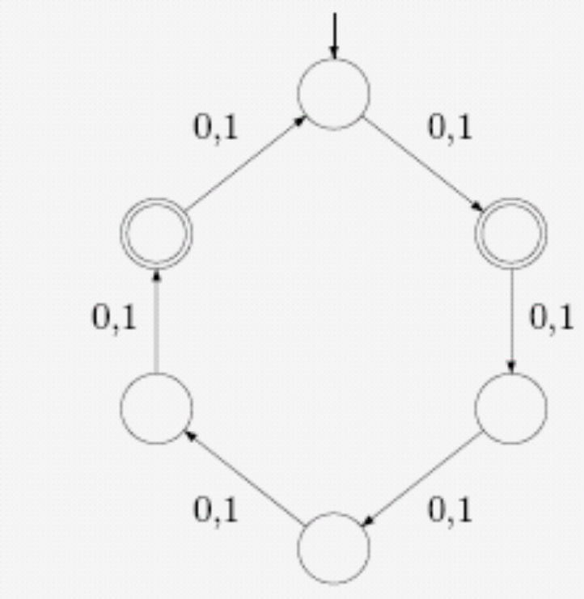
DFA – design a DFA
1. Building a DFA

Slide 6

DFA – Interpret a DFA

Slide 7
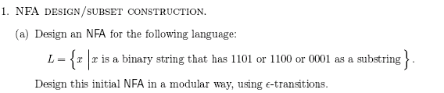
NFA – design a NFA

Slide 8
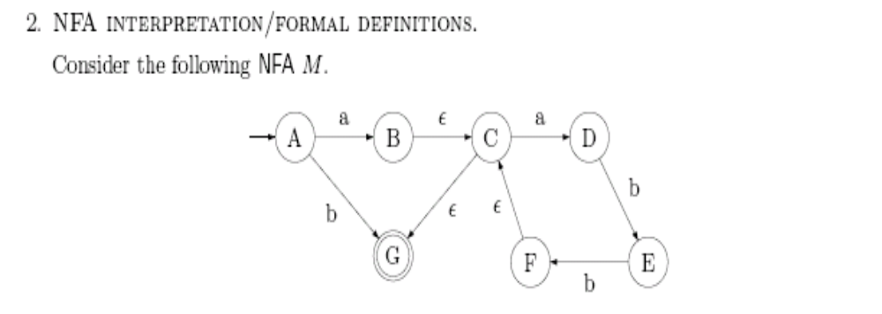
NFA – design a NFA

Slide 9
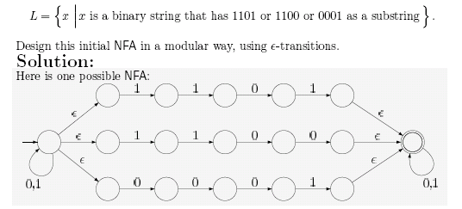
NFA – design a NFA

Slide 10
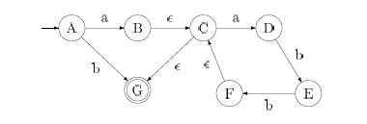
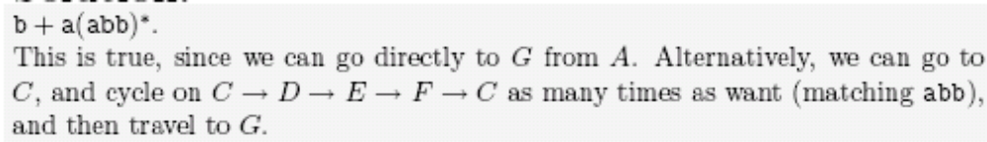
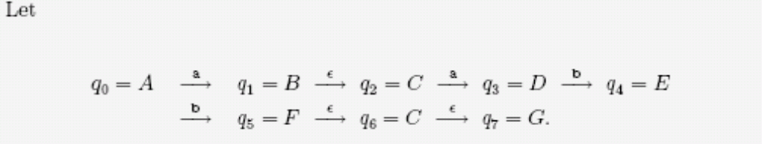
NFA – Interpreting a NFA

Slide 11
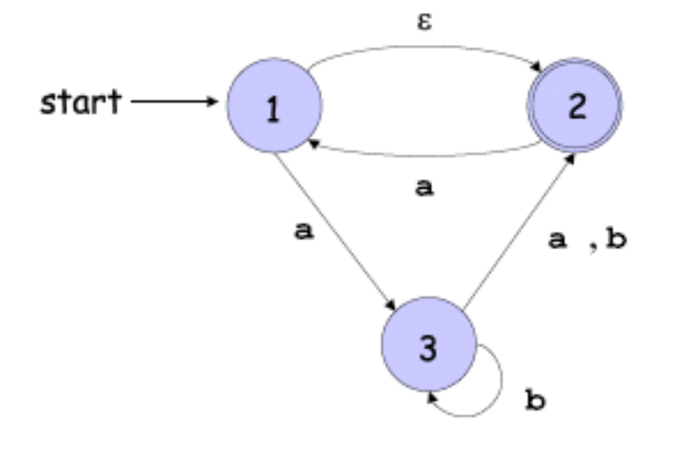
NFA ＝DFA
(a) Give a formal description of the following NFA:
(b) Use the construction given in Notes to convert the above NFA to an equivalent DFA.

Slide 12
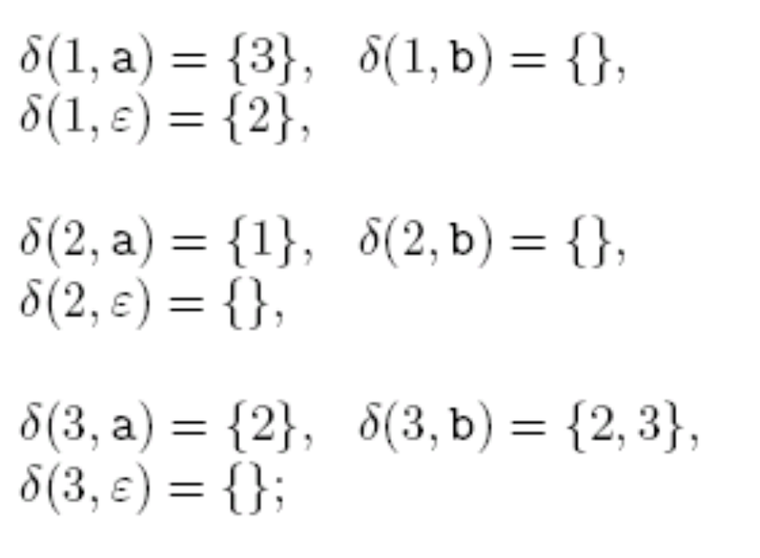
NFA ＝DFA

Slide 13
NFA ＝DFA
a,b
φ
a
{123}
b
b
a
{23}
{12}
a
b

Slide 14
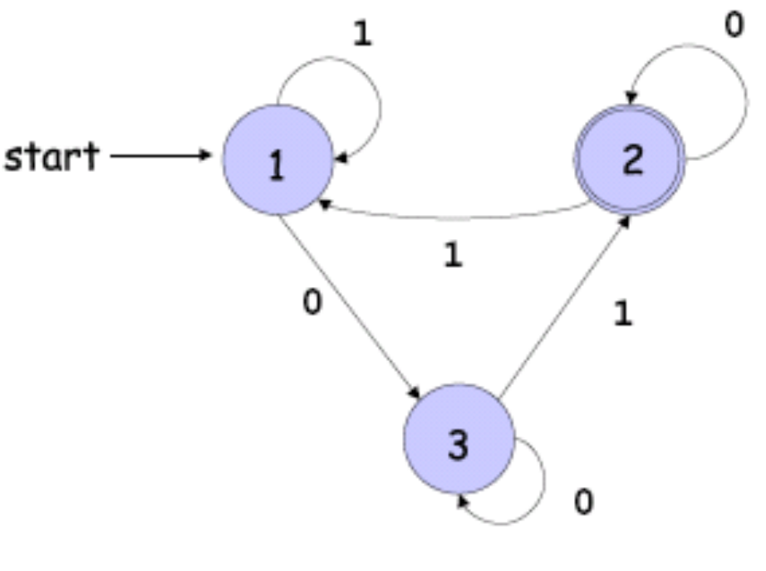
Property of RL
Let A/B ={w| wx ∈ A for some x ∈ B}
(a) Suppose that A is a language recognized by the following DFA:
Also, suppose that B = {0^{n}1^{n} |n ≥1}. Design a FA which can recognize the language A/B .

Slide 15
Property of RL
Let A/B ={w| wx ∈ A for some x ∈ B}
(b) In general, show that if A is regular and B is any language, A/B is regular.

Slide 16
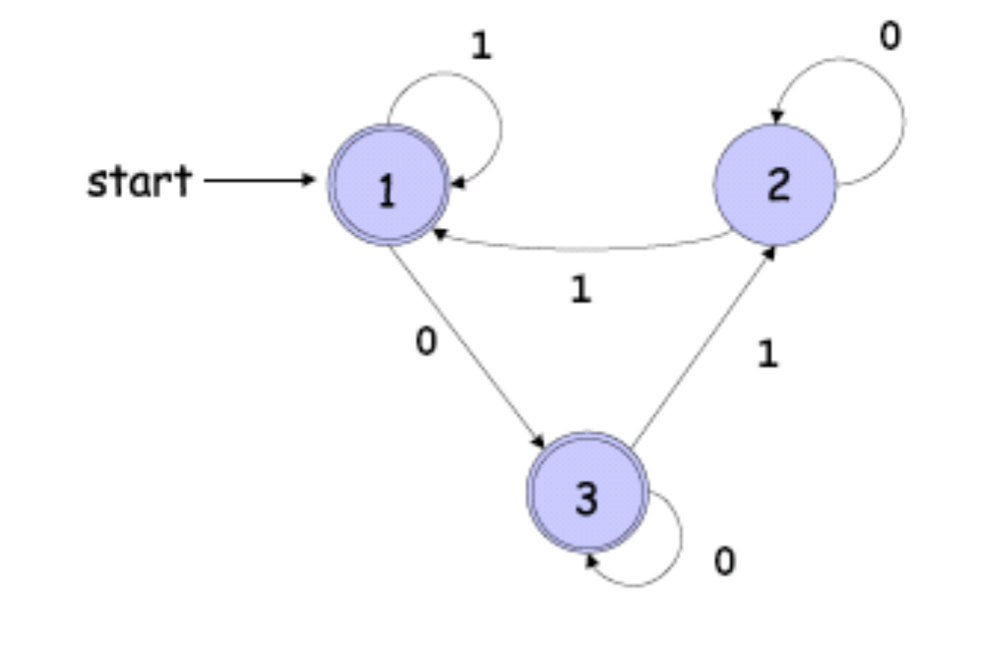
Property of RL
Let A/B ={w| wx ∈ A for some x ∈ B}
DFA can be constructed shown as following graph

Slide 17
Property of RL
Ans: Consider the DFA for language A, and consider processing strings starting from the start state. Then, strings in 0,1 can be classified into three classes:
Those that will exactly reach State 1,
those that will exactly reach State 2, and
those that will exactly reach State 3.
For strings reaching State 1 or State 3, any one of them will reach an accept state of the DFA if 01 is further read from the input. As 01 is in B, by definition, all such
strings reaching State 1 or State 3 are in A/B.

Slide 18
Property of RL
(i)Those that will exactly reach State 1,
(ii)those that will exactly reach State 2, and
(iii)those that will exactly reach State 3.
For strings reaching State 2, any one of them will not reach an accept state of the DFA no matter which string of B is further read from the input. By definition, all
such strings are not in A/B.
Based on the above reasoning, we see that if we modify the DFA for language A by setting State 1 and State 3 to be accept state, and State 2 to be nonaccept state, the
resulting DFA will recognize A/B.

Slide 19
Property of RL
(b) Ans: For a state q in a DFA and a string w, we extend the notation of δ such that δ(q,w) denotes the state exactly reach when we process w starting at state q. In general, we can construct a DFA M_{A/B} for A/B from the DFA M_{A} for A just by modifying the set of accept states. In particular, a state q is an accept state of M_{A/B} if and only if for some w∈B, δ(q,w) is an accept state of M_{A}. Then, it is easy to check that this constructed DFA M_{A} recognizes the language A/B.

Slide 20
Property of RL
L ={w| w含有至少3个a和至少2个b}
(a) L1={w| w含有至少3个a}
a,b
b
b
b
a
a
a
q₁
q₂
q₃
q₄
(b) L2={w| w含有至少2个b}
a
a
a,b
b
b
q₁
q₂
q₃

Slide 21
Property of RL
L ={w| w含有至少3个a和至少2个b}
a
a
a
a
a
b
a
b
b
a
b
a
b
b
b
b
a
a
a
b
b
b
a,b

Slide 22
RE
1 Building and interpreting regular expressions.
Give regular expressions for the following languages over the alphabet ∑= {a, b, c}
(a) La ={w | (|w|) is a multiple of 3 and w starts with aa}
(b) Lb = {w | w does not contain two consecutive b's }
2 Describe the languages represented by the following regular expressions:
(a ∪ b ∪ε )((a ∪ b)(a ∪ b)(a ∪b))*(a ∪ b ∪ ε).

Slide 23
RE
La ={w | (|w|) is a multiple of 3 and w starts with aa}
aa
(b) Lb = {w | w does not contain two consecutive b's }
(a∪b ∪c)
( )*
(a∪b ∪c) (a∪b ∪c) (a∪b ∪c)
every b must be followed by an a or a c, unless it occurs at the very end of the string. We can capture this with the expression
((b∪ε) (a∪c))*
(b ∪ε)

Slide 24
RE
Describe the languages represented by the following regular expressions:
(a ∪ b ∪ε )((a ∪ b)(a ∪ b)(a ∪b))*(a ∪ b ∪ ε).
(a ∪ b ∪ε)
(a ∪ b)^{3i}
for any i>=0
(a ∪ b ∪ε)
(a ∪ b)^{3i +j}
For any 0<=j<3, we can have
Solution: for any string made out of k characters can be represented by this expression, since we can get i=[k/3] and j=k mode 3 .Now k=3i+j.
This is equivalent to (a+b)*, i.e. all strings of a’s and b’s

Slide 25
Pumping lemma
反证法,即A是正则的。
Let p be the pumping length, and take 足够长的word s = a^{p}ba^{p}ba^{p}b , clearly, s∈A.
Let s = xyz = a^{p}ba^{p}ba^{p}b,
with condition 1) |xy|≤p 开讲后不久就打圈
Only one option:
y=a^{k} (1≦k≦p), x=a^{p-k} ,z=ba^{p}ba^{p}b
with xyyz = a^{p+k}ba^{p}ba^{p}b ∉ A
Thus, a contradiction occurs. So the assumption is wrong ,and A is not regular.

Slide 26
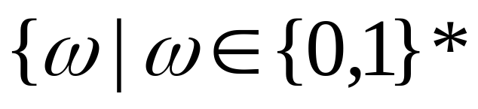
Pumping lemma
Prove that the following languages are not regular. You may use the pumping lemma and the closure of the class of regular languages under union, intersection, and complement.
is a palindrome}

Slide 27
Pumping lemma
is a palindrome}
反证法,即PAL={w|w ∈{0,1}* is a palindrome}是正则的。
Let p be the pumping length, and take 足够长的word
s = 0^{p}10^{p} , clearly, s∈PAL.
Let s = xyz = 0^{p}10^{p},
with condition 1) |xy|≤p 开讲后不久就打圈
Only one option:
y=0^{k} (1≦k≦p), x=0^{p-k} ,z=10^{p}
with xyyz = 0^{p+k}10^{p} ∉ PAL
Thus, a contradiction occurs. So the assumption is wrong ,and PAL is not regular.

Slide 28
作业
The key idea is to design three states q0; q1; q2, where
  q0 specifies the input string does not end with 0,
  q1 specifies the input string ends with exactly one 0,
  and q2 specifies the input string ends with at least two 0s.
1
0
0
0
q₀
q₁
q₂
1
1

Slide 29
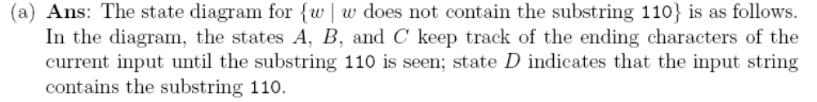
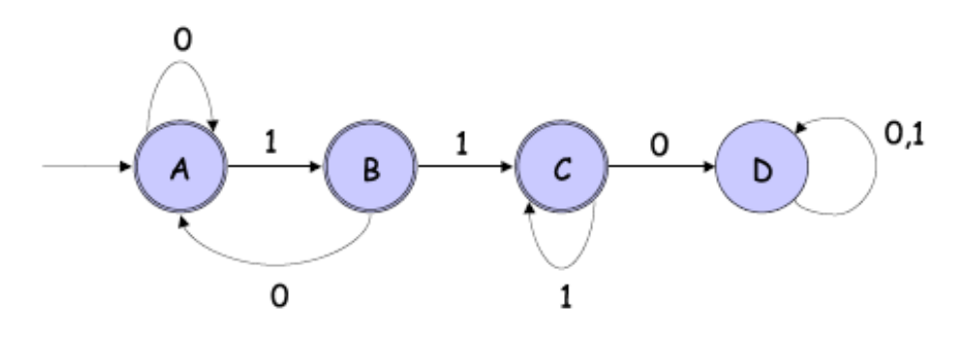
作业
Give state diagrams of DFAs recognizing the following languages. In both parts,the alphabet is {0, 1}:
(a) {w| w does not contain the substring 110}
(b) {w| w is any string except 11 and 111}

Slide 30
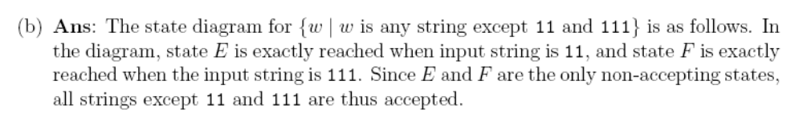
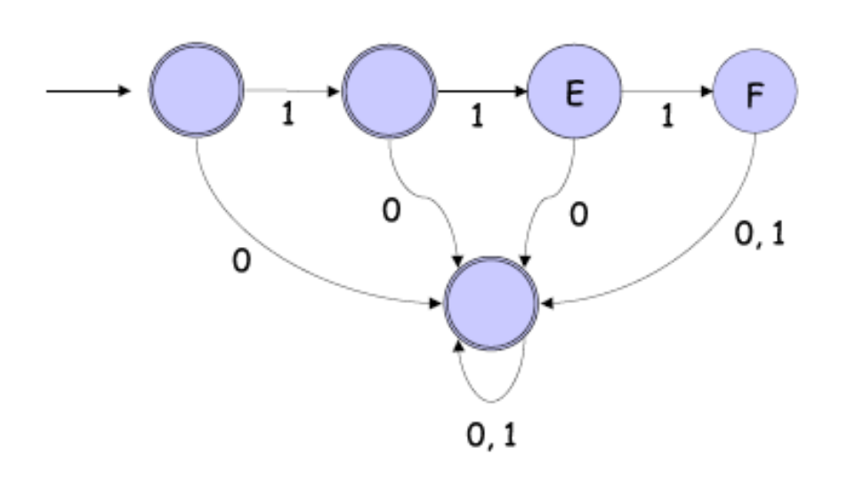
作业
Give state diagrams of DFAs recognizing the following languages. In both parts,the alphabet is {0, 1}:
(a) {w| w does not contain the substring 110}
(b) {w| w is any string except 11 and 111}

Slide 31



作业
Answer: Suppose on the contrary that this language L is regular. Let p be its pumping length and t be a prime greater than p. (Note that t exists since the number of primes is infinite.) Then , and by the pumping lemma, we can write for some x,y, z, such that
By setting i = t + 1, the pumping lemma implies that
is in L. On the other hand,
Thus, a contradiction occurs, so that L is not regular.

Slide 32
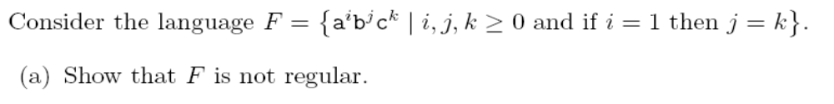
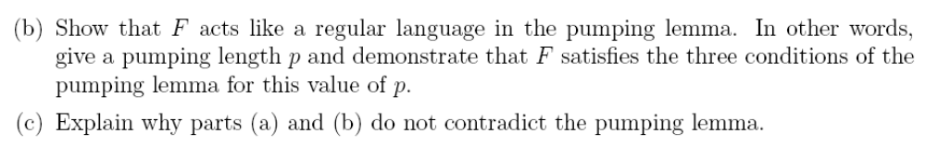
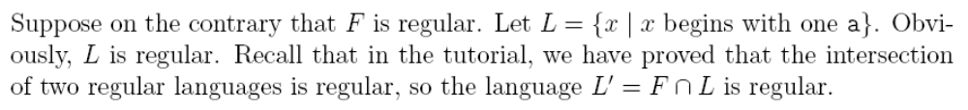
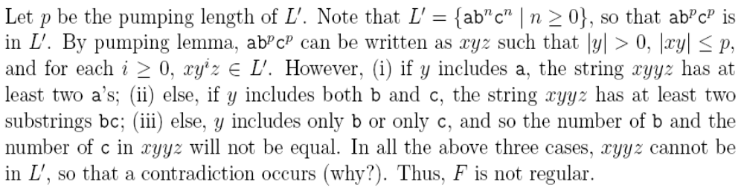
作业

Slide 33

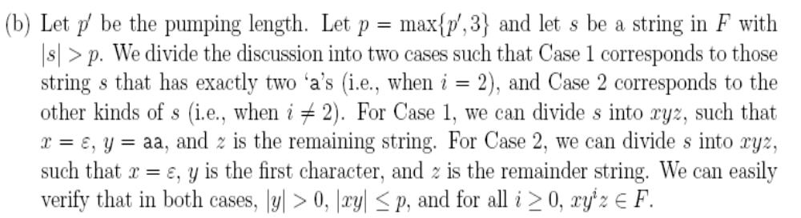
作业

Slide 34
作业

Slide 35
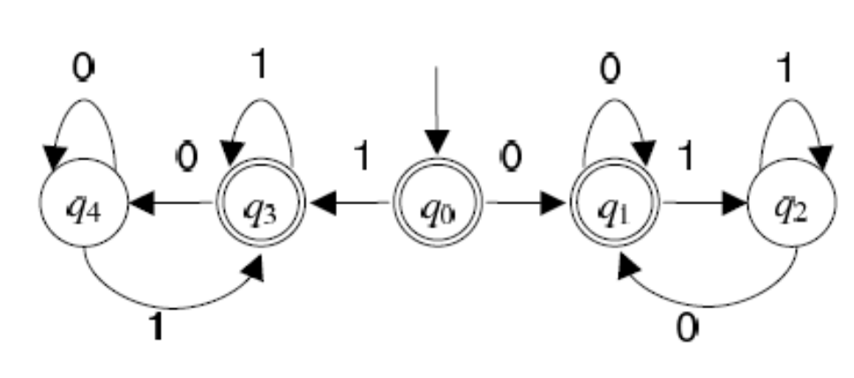
Nonregular Languages §2.4 cp 47
也需要计数，感觉似乎不正则，事实上是正则的。
The key observation is that the number of occurrences of the substrings 01 and 10 can differ by at most 1. In the figure below, the states q2 and q4 refer to the cases when the difference is exactly 1 (q2 when 01 has one more occurrences, q4 when 10 has one more occurrences).

